Slide 1
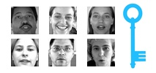
Facial Keypoints Detection
— W207 Final Project —
Swati Akella, Tom Hamnett, Changjing Zhao

Slide 2
Executive Summary
Built CNN-based model to predict facial keypoints from set of Images
Used Tensorflow Keras on Google Colab with TPU accelerator
Improved RMSE substantially from baseline using data augmentation, Conv2d Layers, Dropout, hyperparameter tuning / scheduling, and Specialist models
Public score of Kaggle submission suggests model would rank #27 out of 175 submissions
Valuable learning experience on how to build, train, and tune neural network models

Slide 3
Agenda
Data Exploration, Transformation, and Augmentation
Model Iterations: Evaluation & Loss Comparison
Specialist Models
Key Learnings and Next Steps

Slide 4
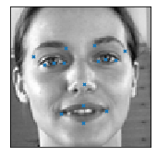
Data Exploration and Cleaning
Rows: 7049 observations
Columns: 31 variables
Training :
80%: 1712
Baseline
Model
Flipping
Blurring
…
Inputs (Images): 1 text variable containing
96x96 = 9216 pixels per
each image
Output Variables (Keypoints): 30 facial keypoint coordinates
2140 observations with all 31 variables populated
Dev:
20%: 428
Notes:
This project includes a training and a validation data set.
The training has 7049 observations and 31 variables.
Of the 31 variables, 30 are dependent variables. 1 text variable, containing 9216 features is the independent variables.
Potential overfitting
How do we deal with Nas.
We tried three me: dropping, forward fill, method for the specialist model for each feature,
Talk about different routes.
Specilist models, we only trained on full dataset for each future.
Forward filled them

Slide 5
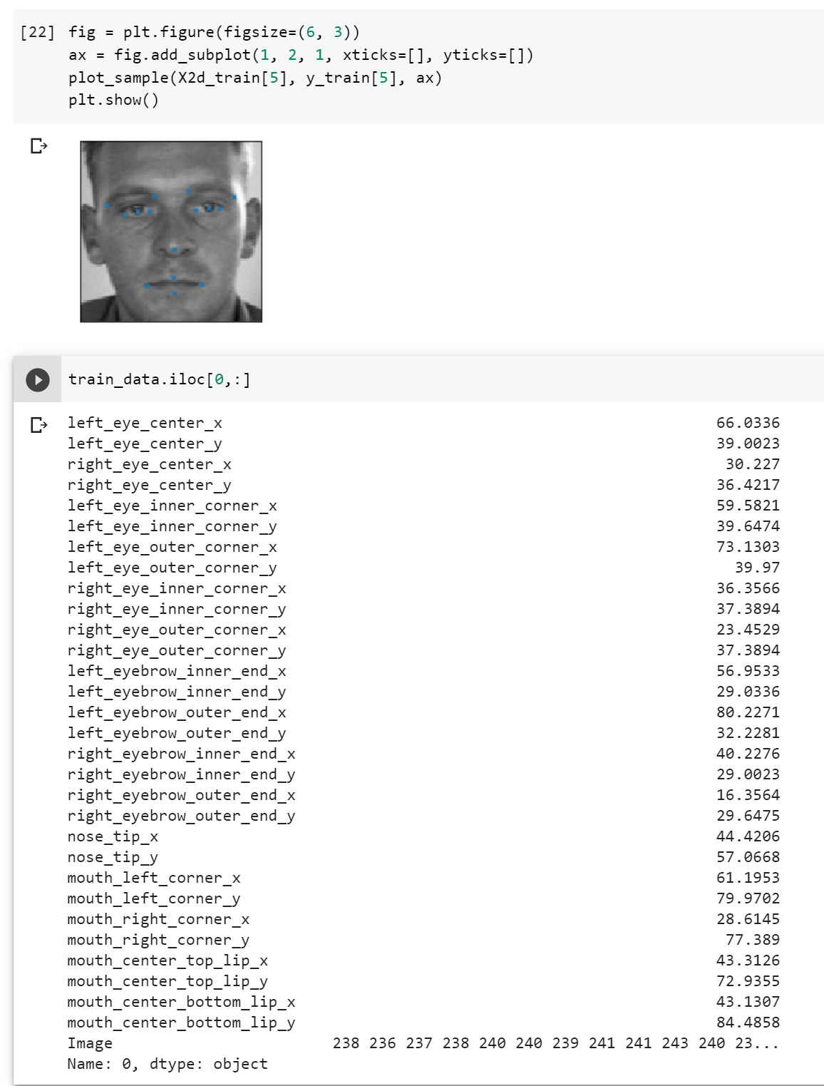
Data Exploration and Cleaning
Inputs (Images): String to array;
96x96 = 9216 pixels per image
Outputs (Keypoint coordinates)::
15 pairs of coordinates of facial key points
Normalization
Image values to [0,1]
Keypoint values to [-1,1]

Slide 6
Data Augmentation - Rationale
Overfitting
9216 features (input variables)
2140 observations (training data size)
30 outcome variables (output variables)
Notes:
Recall that we have 9216 features as the input and 30 target values as the output, but we only have 2,140 observations to train.
We have many more input dimensions (9,216) than the size of he training data, which is an indicator that overfitting might become a problem.
Our first solution is to enrich the variance of the training data.

Slide 7
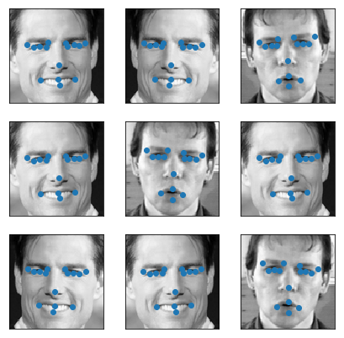
Data Augmentation - Flipping
Methodology
Image (Input Values): Reverse each row in image
Keypoints (Target Values)
Swapped features that represented ‘left’ and ‘right’
Multiplied features that represent an ‘x’ coordinate by -1 to reverse location horizontally
Notes:
Flipping is to create an mirror image of the current pictures.
From the coding perspective, x values all need to multiply by negative 1. For Y values, all left variables are to be swopped with right variables.
For example, left_eye_center will now become left_eye_center.
With this technique, we essentially doubled the size of our training data. Later in the presentation, we will review its performance.

Slide 8
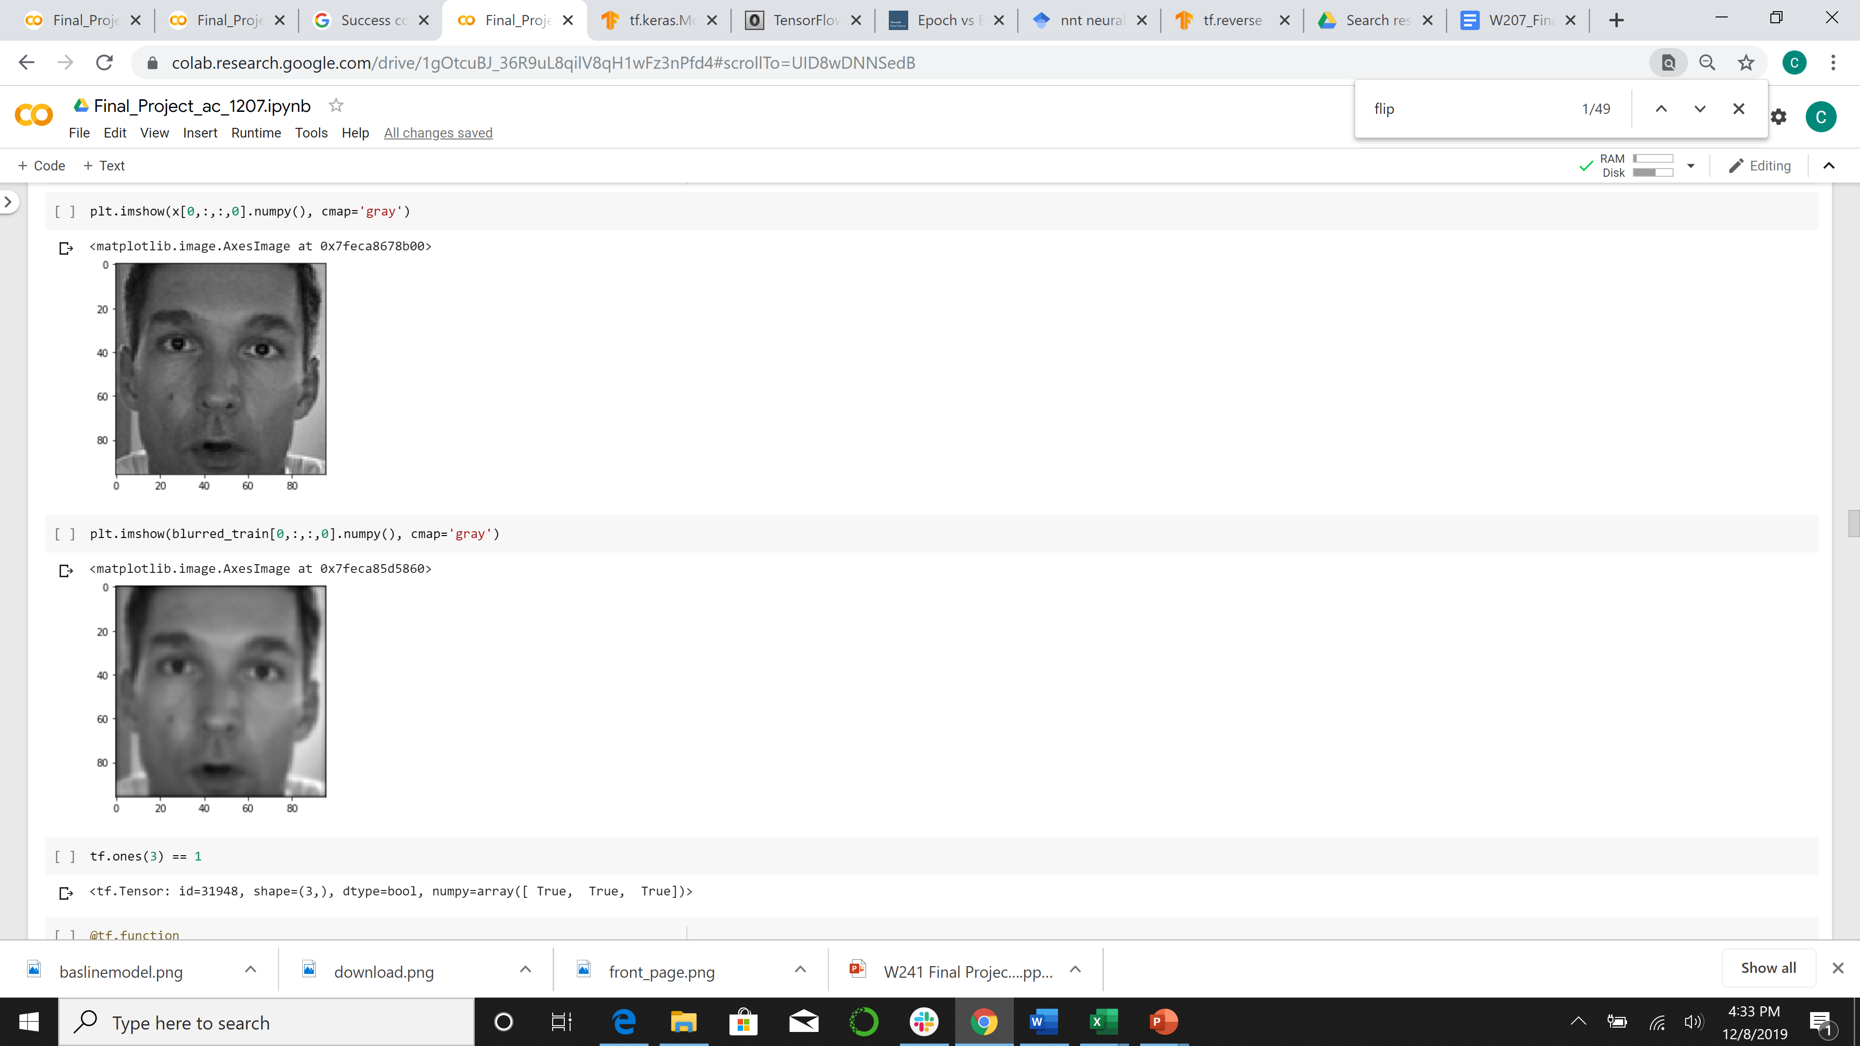
Data Augmentation - Blurring
Rationale
Methodology
Implementation
Notes:
The next augmentation technique we tried is blurring.
Unlike flipping, for blurring, we only need to apply the Gaussian functions to the X values. We do not need to change anything for Y.

Slide 9
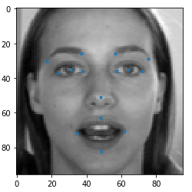
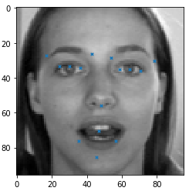

Data Augmentation – Histogram Stretching
Rationale
Methodology
Implementation
Notes:
What does histogram stretching do?
This augmentation enhances the contrast of an image by “stretching” the range of pixel values
This is done through a linear scaling of pixel values.
Process:
An image is scanned for minimum and maximum pixel intensity, represented by “A” and “B”.
A desired range of pixel intensity is specified. Let “L” be the lower bound and “U” be the upper bound.
Then each pixel value “P” in the original range [A,B] is mapped to a new value “Pi” in the desired range of [L,U] such that the proportion of each pixel intensity in the range does not change.
When augmenting our dataset, we selected the 5th and 95th percentile for “A” and “B” respectively in order to prevent outliers from affecting the range.

Slide 10
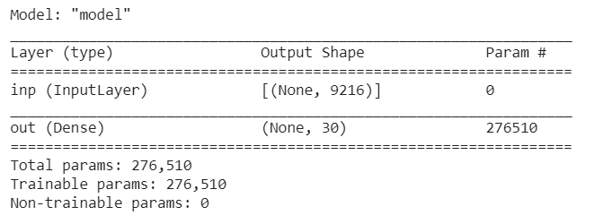
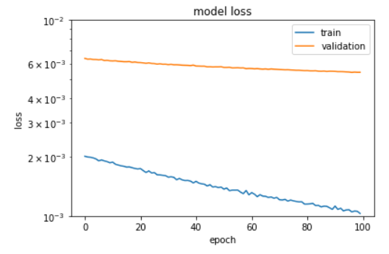
Baseline
Single dense layer with linear activation
Optimizer - SGD
1D Input data used in the model
Low Learning rate (0.001) and
High Momentum (0.99)
Model Evaluation: RMSE – 3.53
Severe overfitting
Notes:
Baseline model: 100 epochs on a single dense linear activation layer
RMSE of 3.53 – established benchmark to improve upon
Model severely overfits from the start and barely improves with epochs

Slide 11
Building and Testing Models
Number of Hidden Layers, Max Pooling and Strides
Dropout Rate
Batch Size
Epochs
Learning Rates and Momentum
Early Stopping and Model Checkpoints
Notes:
When building models, our goal was to minimize Root Mean Squared Error while training the model faster and reducing overfitting. We experimented with multiple layers and hyperparameters shown in the slide. IN this presentation we want to walk you through 5 models. In all these models we have used SGD optimizer with relu activations. In the final dense layer linear activation is used.

Slide 12
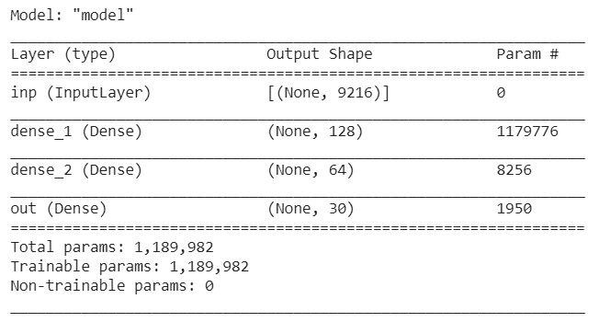
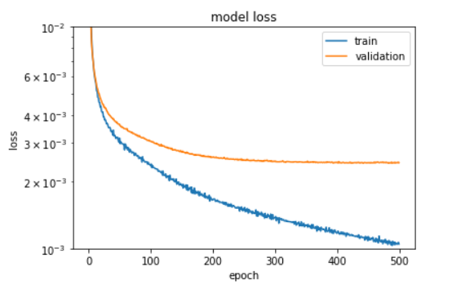
Model 1
Optimizer - SGD
1D Input data used in the model
Low Learning rate (0.001) and
High Momentum (0.99) used in training
Model Evaluation: RMSE – 2.37
Overfitting starts early
Notes:
Our initial model was built with 1 dimensional input data. We started with a low learning rate of 0.001 and a high momentum of 0.99.
Though there was a significant improvement in error, we noticed that overfitting started early on.

Slide 13
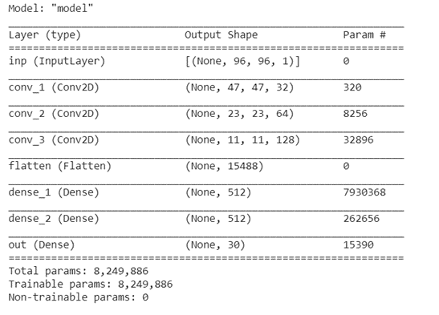
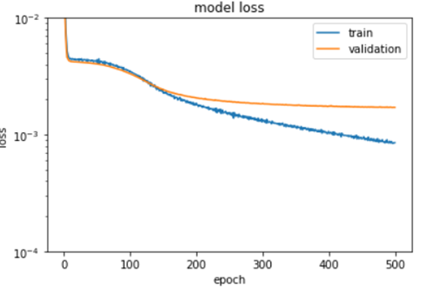
Model 2
Converted dataset to 2D array
Included 2D Convolutional Layers and Strides
Model Evaluation: RMSE – 1.99
Notes:
In the next model, we converted the input into 2 dimensions. We added three 2D convolutional layers along with strides.
When researching CNN for image recognition, we read that max-pooling could be replaced by a convolutional layer with increased stride without a loss in accuracy. Due to the benefit of reduced computation time, we focused on building models with convolutional layer with strides.
The error dropped from 2.37 in the previous model to 1.99
However, we continued to face early overfitting in our model.

Slide 14
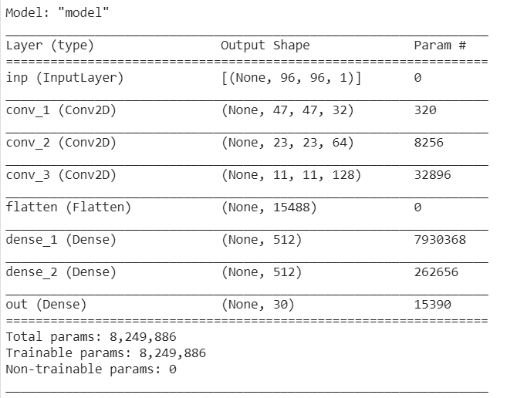
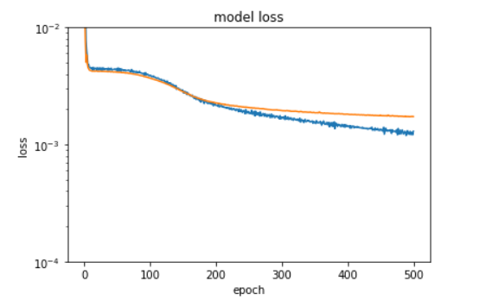
Model 3
Data augmentation with random flips
Model Evaluation: RMSE – 2.00
Effect of Strides ~= Blurring
Notes:
To address overfitting, we included randomly flipped images in our input and output data.
This allowed us to benefit from data augmentation without increasing the training time.
We also experimented with blurring and stretching, however our model performance deteriorated so we decided not to proceed with these data augmentations.

Slide 15
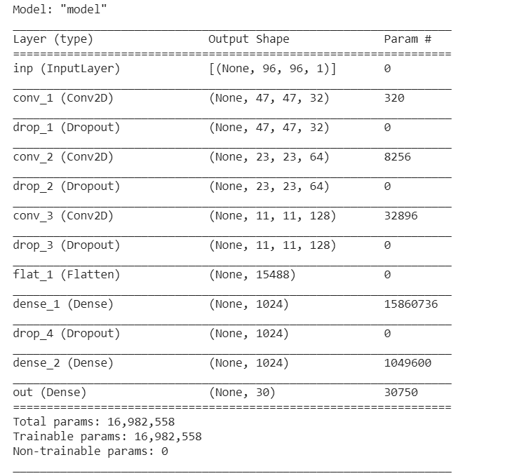
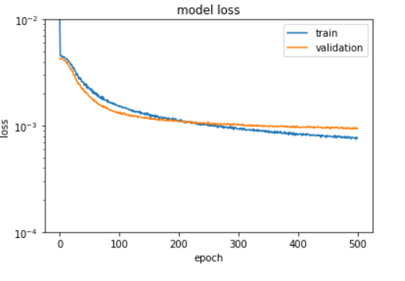
Model 4
Dropout layers added to improve overfitting
Model Evaluation: RMSE – 1.98
Notes:
In our next model, we added 4 dropout layers, one after each convolutional layer to reduce overfitting.
We started with a low dropout rate and then experimented on it before finalizing our main model.

Slide 16
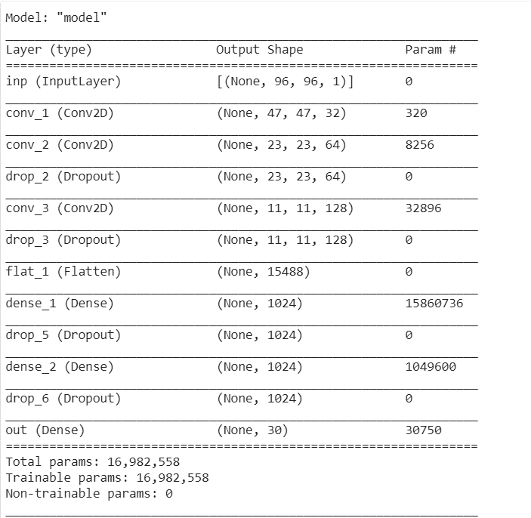
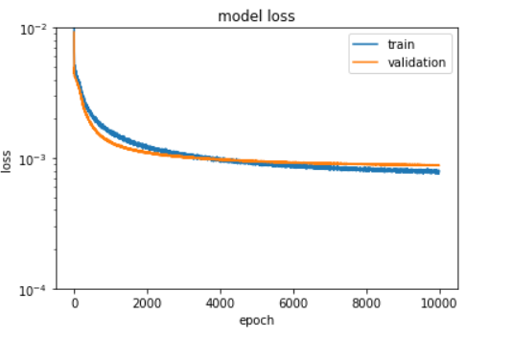
Main Model
Increased dropout rate
Custom callback added for Learning Rate and Momentum
Updated maximum recursion function to run 10,000 epochs
Model Evaluation: RMSE – 1.42
Notes:
We spent considerable time fine tuning hyperparameters
We noticed that a higher dropout rate helped with overfitting.
A High learning rate and low momentum that decreased over time helped with error reduction. These parameters were included in a custom callback.
We also increased the maximum recursion limit in order to run 10000 epochs.
All this fine tuning helped reduce the error to 1.42
We saved this model for reuse and further modifications

Slide 17
Specialist Models
Non-Null Records by Keypoint Group
Group of endpoints had different number of null records
Main model trained on full set of non-null records
We train specialist models on keypoint groups with similar number of non-null records to take advantage of data we initially ignored in main model
All Non-Null Records
Eye Centers
Eye Corners
Eyebrows
Nose
Mouth Corners & Top Lip
Bottom Lip

Slide 18
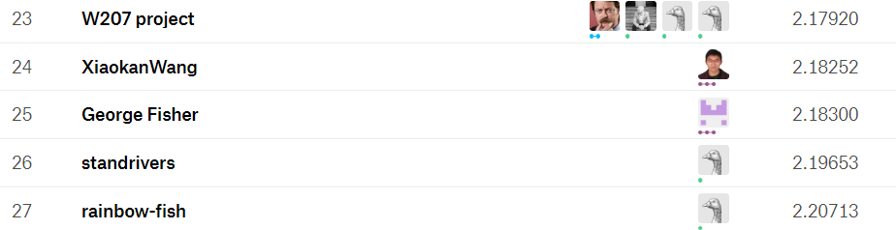
Kaggle Submission
Private Score
Public Score
Kaggle submission compared to Public Leaderboard suggests our model would have scored 27 / 175 in Kaggle competition
Just below our benchmark goal of team ‘W207 Project’ from 3 years ago (so close!)
Public Leaderboard

Slide 19
Summary of Learning
Tradeoff between computation time and accuracy
LR tuning very important in RMSE
Data augmentation effective in improving RMSE
Dropout also highly effective, but large dropout necessitated higher LR
Using *all* the data (via Specialist models) effective in improving on main model
Overall, gained experience in neural network modeling ☺

Slide 20
Next Steps
Experimenting with additional data augmentations (perturbing image via rotations, zooming, etc.)
Additional layers? More tuning? Higher number of epochs? Many possible options to continue to iterate and improve model

Slide 21
Q&A

